Slide 1
Agenda for GEOG260/360 GIS & Land Change Models
Today
Update from Clark Labs concerning access to TerrSet
Introduction of Teaching Assistant Shushil Paudel
Message from the DCR of the Congo reveals why you need this course
Staff at TerraCarbon show that you can make a career from the concepts in this course
Philosophy of Modeling
Before Next Class
Download ForestOtherBuilt2.zip from Canvas. Put the files into a folder where you will work.
Use CROSSTAB to compute a table of numbers where the row categories derive from 1971Built1.rst and the column categories derive from towns01.rst.
Use CROSSTAB to compute a table of numbers where the row categories derive from 1985Built1.rst and the column categories derive from towns01.rst.
Use CROSSTAB to compute a table of numbers where the row categories derive from 1999Built1.rst and the column categories derive from towns01.rst.
Come to class prepared to discuss how to make a recent trends scenario for each town.
See https://www.theguardian.com/environment/2023/jan/18/revealed-forest-carbon-offsets-biggest-provider-worthless-verra-aoe
and a response at https://www.sylvera.com/blog/guardian-offsets-response
September 4
No Class
September 6 Deadline for Add/Drop
Discuss Assignment 1
September 11
Introduction to Geomod
September 13
Geomod land change allocation model in TerrSet
Assignment 1 is due at 4pm via Canvas
September 15 Deadline to declare Pass/Fail Grade

Slide 2
Your status as a Clark student entitles you to a one-year TerrSet Student Starter license at no cost
If you had a previous license, then send an email to clarklabs@clarku.edu to explain that you had a previous license and now want another license for Pontius’ course this semester; include your personal email address. Trish Champlin will be monitoring that inbox of clarklabs@clarku.edu to get you set up.
If you have not had a previous license, then follow the steps below:
1) To place your no charge order go to https://clarklabs.org/buy/.
2) You must use your clarku email, which Professor Pontius sent to Clark Labs.
3) Choose the $49.00 TerrSet 2020| Student Starter (1 Year) - File download
4) Enter Coupon Code: CLARK-SS This coupon code will not work with any other license. Proof of Student Status is not required, so ignore the request for Student Status.
5) Your total will be zero (0) at check out.
6) The download link is contained within the invoice you received when you place your order.
7) After Trish Champlin (tchamplin@clarku.edu) completes the order, you will receive an automated email containing your activation and password information. Please check your junk mail.

Slide 3
Sushil Paudel
Sushil Paudel holds a Master of Science in Forestry from Agriculture and Forestry University, Hetauda, Nepal, and a Master of Science in Geographic Information Science and Systems from Salzburg University, Austria. He has been a Forest and GIS Officer at Expert Group Pvt. Ltd, Nepal, and a part-time GIS and Data Science instructor at Broadway Infosys Pvt. Ltd., Subidhanagar, Nepal. He has been involved in several Forest and Environmental assessment projects where he acquired field data and prepared Forest and Environment Management Plans for government agencies. His major interest is developing practicable forest resource inventory and analysis methodology using UAVs and deep-learning models for forest carbon assessment. Sushil has TerrSet working on his Mac laptop.

Slide 4
Message from DCR of the Congo to Professor Pontius
Dear Professor.
My name is John KIKUNI TCHOWA, Master 2 learner from the regional postgraduate school of integrated planning and management of forests and tropical territories / DRC. As part of my research for the final thesis, I would like to use the analysis programs "Pontius Matrix 22" and "intensity analysis 02.xlms" to analyze the intensity and speed of change in a landscape but I cannot find them online. If it is possible that I will obtain them from you.
Sincerely,
John KIKUNI TCHOWA Ingénieur Agronome_Phytotechnicien (Université de Kolwezi/RDC)
Apprenant en Master 2 AGIFT à l'ERAIFT/Unesco. www.eraift-rdc.org

Slide 5
Pontius’ Response to John from DCR of the Congo
Dear John,
I recommend you read chapters 1, 4, 7, and 12 of the attached book. See also the two attached journal articles for the most recent developments of Intensity Analysis. Use the attached Excel file to analyze each time interval. To learn how to use the Excel file, watch the first video entitled PontiusMatrix42 Instructional Video at https://www2.clarku.edu/faculty/rpontius/videos.html . To analyze multiple time intervals simultaneously, download IntensityAnalysis03.xlsm via item 38 at http://www2.clarku.edu/~rpontius/ You might also be able to use the R package at https://cran.r-project.org/web/packages/intensity.analysis/
I hope you eventually consider applying to our doctoral program. See information at https://www.clarku.edu/departments/geography/graduate-programs/doctoral-programs/.
All the Best,
Robert Gilmore Pontius Jr
PhD and Professor
Graduate School of Geography, Clark University
950 Main Street, Worcester MA 01610, USA

Slide 6
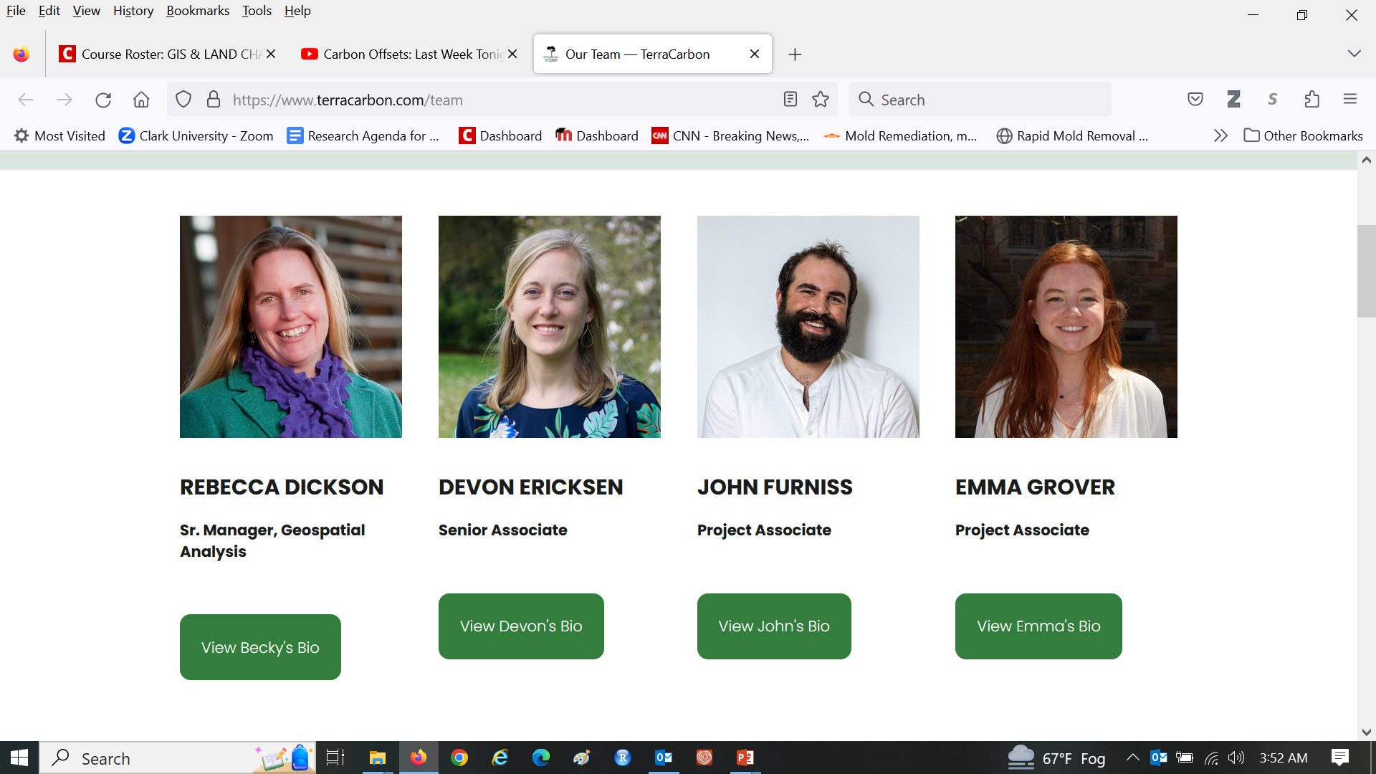
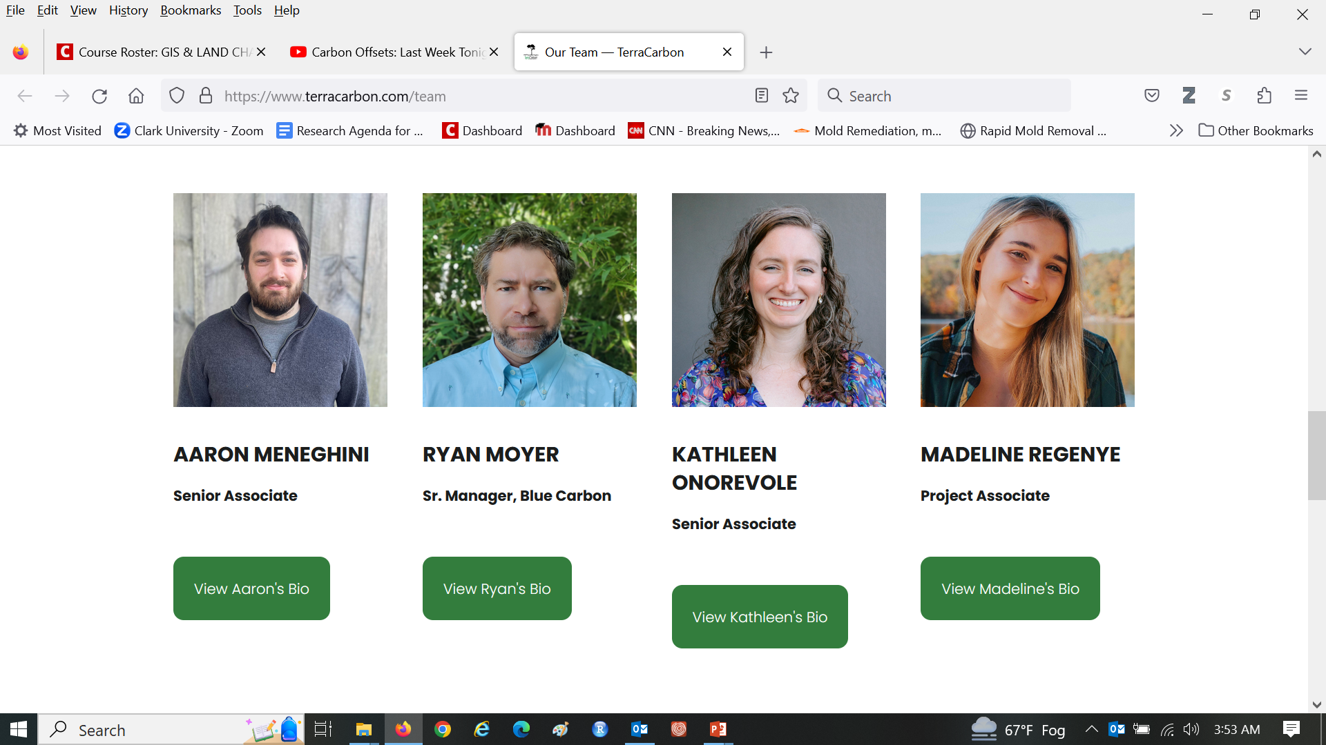
Clark graduates dominate the profession of land change science https://www.terracarbon.com/team

Slide 7
The United States National Science Foundation funds research into Coupled Human and Natural Systems (CHANS), which addresses to questions:
How do humans influence nature?
How does nature influence humans?

Slide 8
Tropical Forests are a coupled human-natural system
How do humans influence tropical forests?
How do tropical forests influence humans?
Who wants to understand the possible future tropical forest scenarios?

Slide 9
Tropical Forests are a coupled human-natural system
How do humans influence tropical forests?
Humans cause deforestation, mostly for agriculture because humans like to eat.
How do tropical forests influence humans?
Land change accounts for about 15-20 percent of greenhouse gas emissions, mostly due to tropical deforestation and forest degradation. Tropical deforestation increases the likelihood of viruses jumping from animals to humans. Tropical forests are a source of minerals for your iPhones and electric cars.
Who wants to understand the possible future tropical forest scenarios?
Scientists who study climate change, biodiversity, viruses, agriculture, genocide, etc.
Clark Professors Sangermano, Estes, Williams, Rogan, Pontius, and Eastman.
Professionals at Conservation International, MapBiomas, TerraCarbon, and Verra.

Slide 10
Discussion Questions
Who caused climate change, how, and why?
Should the role of wealthy industrialized countries differ from the role of other countries in reducing greenhouse gas emissions?
Why are tropical countries destroying their forests?
What would be a sufficient incentive for tropical countries to reduce deforestation?
Who should pay for the incentive?
Do those who should pay have the necessary resources and incentives to pay?
How can we motivate those people to pay?
Who should get paid to change their behaviors?
The people who stop deforestation will do what instead?
The project proposers will do what with a carbon credit?
Who should be responsible that the system works in a legitimate effective way?

Slide 11
Clean Development Mechanism for carbon offset projects
Annex I countries invest in emissions reducing projects in developing countries, which is an alternative to more costly emission reductions in Annex I countries.
The plan is project-based, incentive-based, and market-driven.
The Clean Development Mechanism aims:
to assist Annex I countries to achieve targets.
to assist Annex II countries to achieve sustainable development.
Characteristics:
Activities must create measurable reductions and be tradable.
Reductions must be additional, meaning that reductions would not have occurred in absence of the project activity.
Participation is voluntary.

Slide 12
Forestry based carbon offset projects are aimed at Reducing Emissions from Deforestation and Forest Degradation (REDD) How would you measure the effectiveness of REDD projects?

Slide 13
How do you measure the effectiveness of forest protection?
Use a simulation model to extrapolate forest loss assuming no protection, which is called the baseline.
Demonstrate that your model extrapolates the baseline accurately.
Protect part of the region from deforestation.
Wait six years, then award a carbon credit for forest persistence in the part of the protected region that the simulation extrapolated forest loss.
Delete from the carbon credit any leakage. Leakage occurs when the protection inspires people to deforest elsewhere, thus negating the effectiveness of the protection.

Slide 14
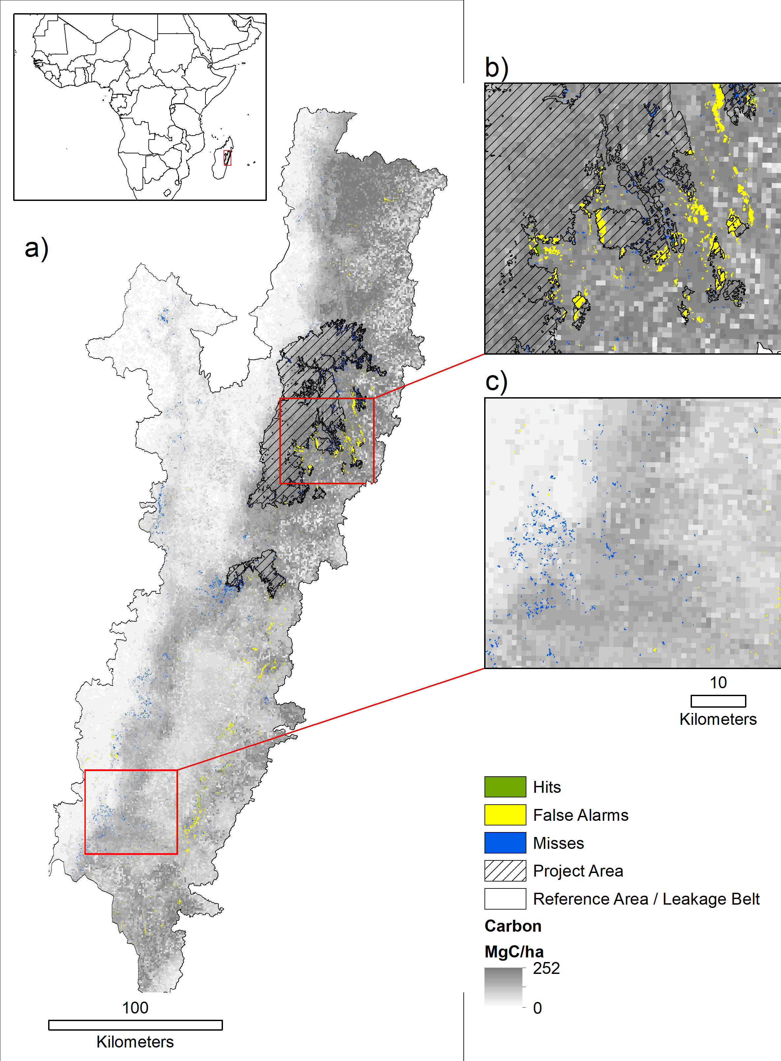
Reducing Emissions from Deforestation and Forest Degradation (REDD) Madagascar data are from Max Wright at Conservation International This is a collaboration with Professor Florencia Sangermano and an honors thesis of Sadie Murray. Project area is the protected area.

Slide 15
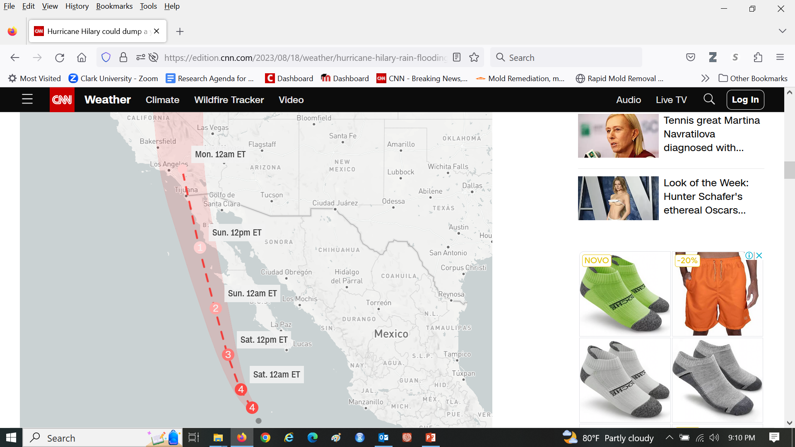
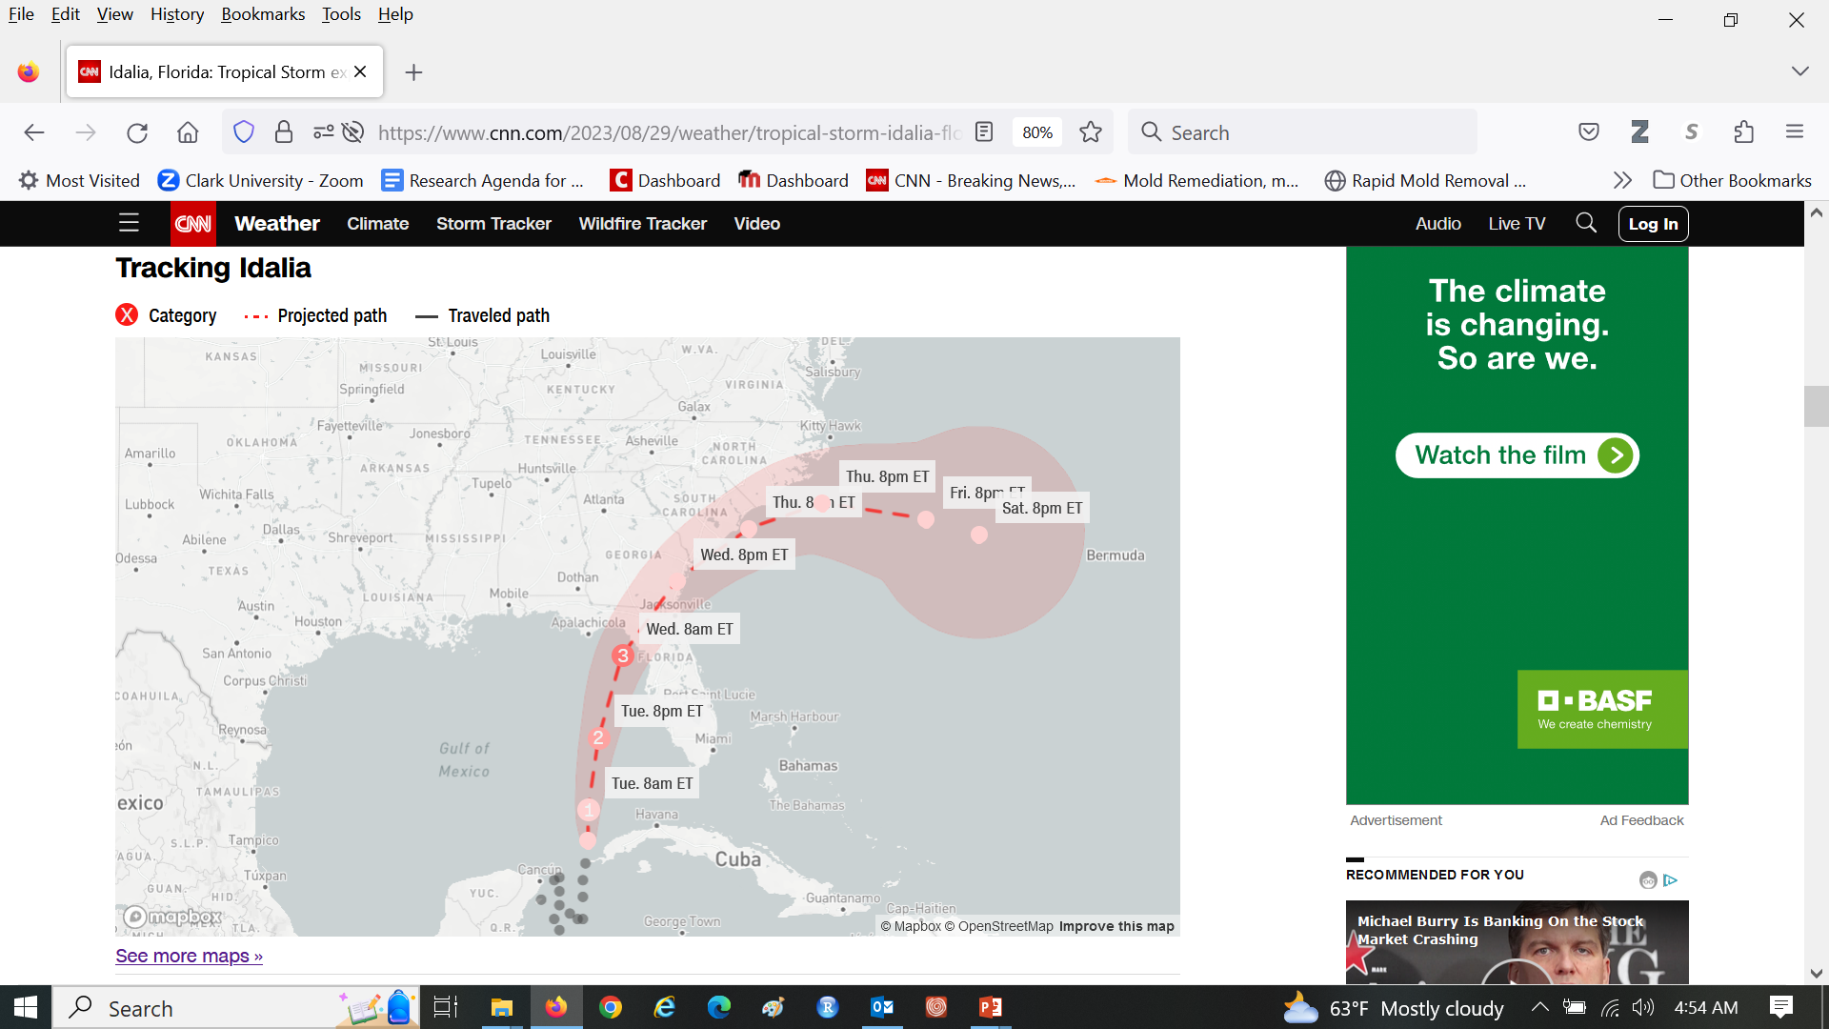
Geographic Information Scientists use models to predict many things, including the paths of hurricanes

Slide 16
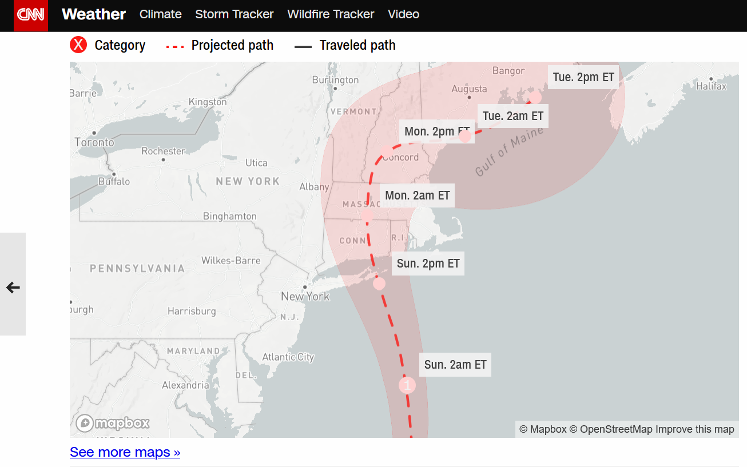
Early forecast of a hurricane for August 2021

Slide 17
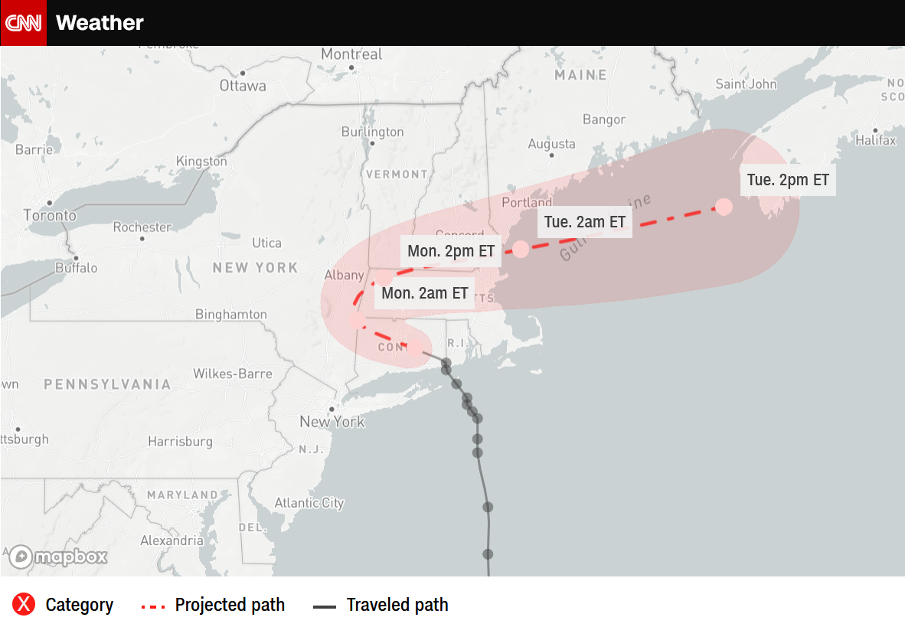
Revised forecast of a hurricane for August 2021

Slide 18
How does the simulation of a Hurricane compare conceptually to the simulation of land change?
Pattern and Process are major themes in simulation modeling.
Pattern describes the data.
A pattern could describe the curvature of the hurricane path.
A pattern could describe the size of the patches of land change.
Process describes the mechanisms that create the patterns.
What are processes that create hurricane patterns? Volcanic eruptions
What are processes that create land change patterns?eg agriculture, building,mining
What types of decisions would humans make based on each type of simulation?
FEMA use it for evacuation purposes, Companies that buy carbon credits, conservationists, etc
How should the simulation of a hurricane differ conceptually from the simulation of land change? Predictions of huricanes might be more difficult, because when it hit in the sea, we are uable to control it, while predictions in land change is morecontrollable.

Slide 19
Suburbanization is a coupled human-natural system
How does suburbanization influence nature?
How does nature influence suburbanization?
Who wants to understand possible future suburbanization?

Slide 20
Suburbanization is a coupled human-natural system
How does suburbanization influence nature?
Suburbanization influences flooding, biodiversity, and human activity that influences nature. For example, suburbanization influences transportation, which influences fossil fuel use, which influences climate change.
How does nature influence suburbanization?
Nature influences suburbanization as coronaviruses, wildfires, water shortages influence where people want to live.
Who wants to understand possible future suburbanization?
Planners for transportation, energy, water, schools, municipal services, conservation, food security, climate change, etc.

Slide 21
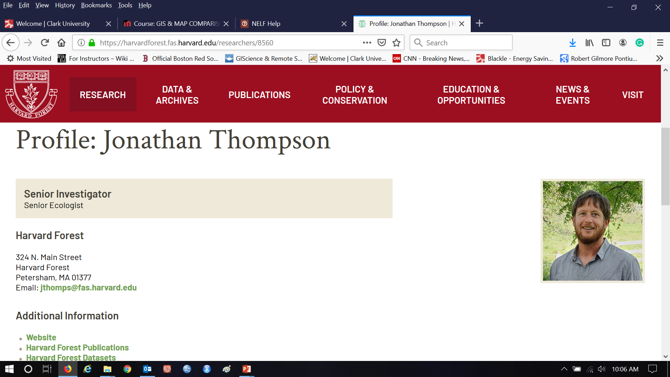

Johnathan Thompson leads New England Landscape Futures (NELF) and delivered a talk at Clark in 2021 https://harvardforest2.fas.harvard.edu/asp/hf/php/researcher_profile1.php?id=8560

Slide 22
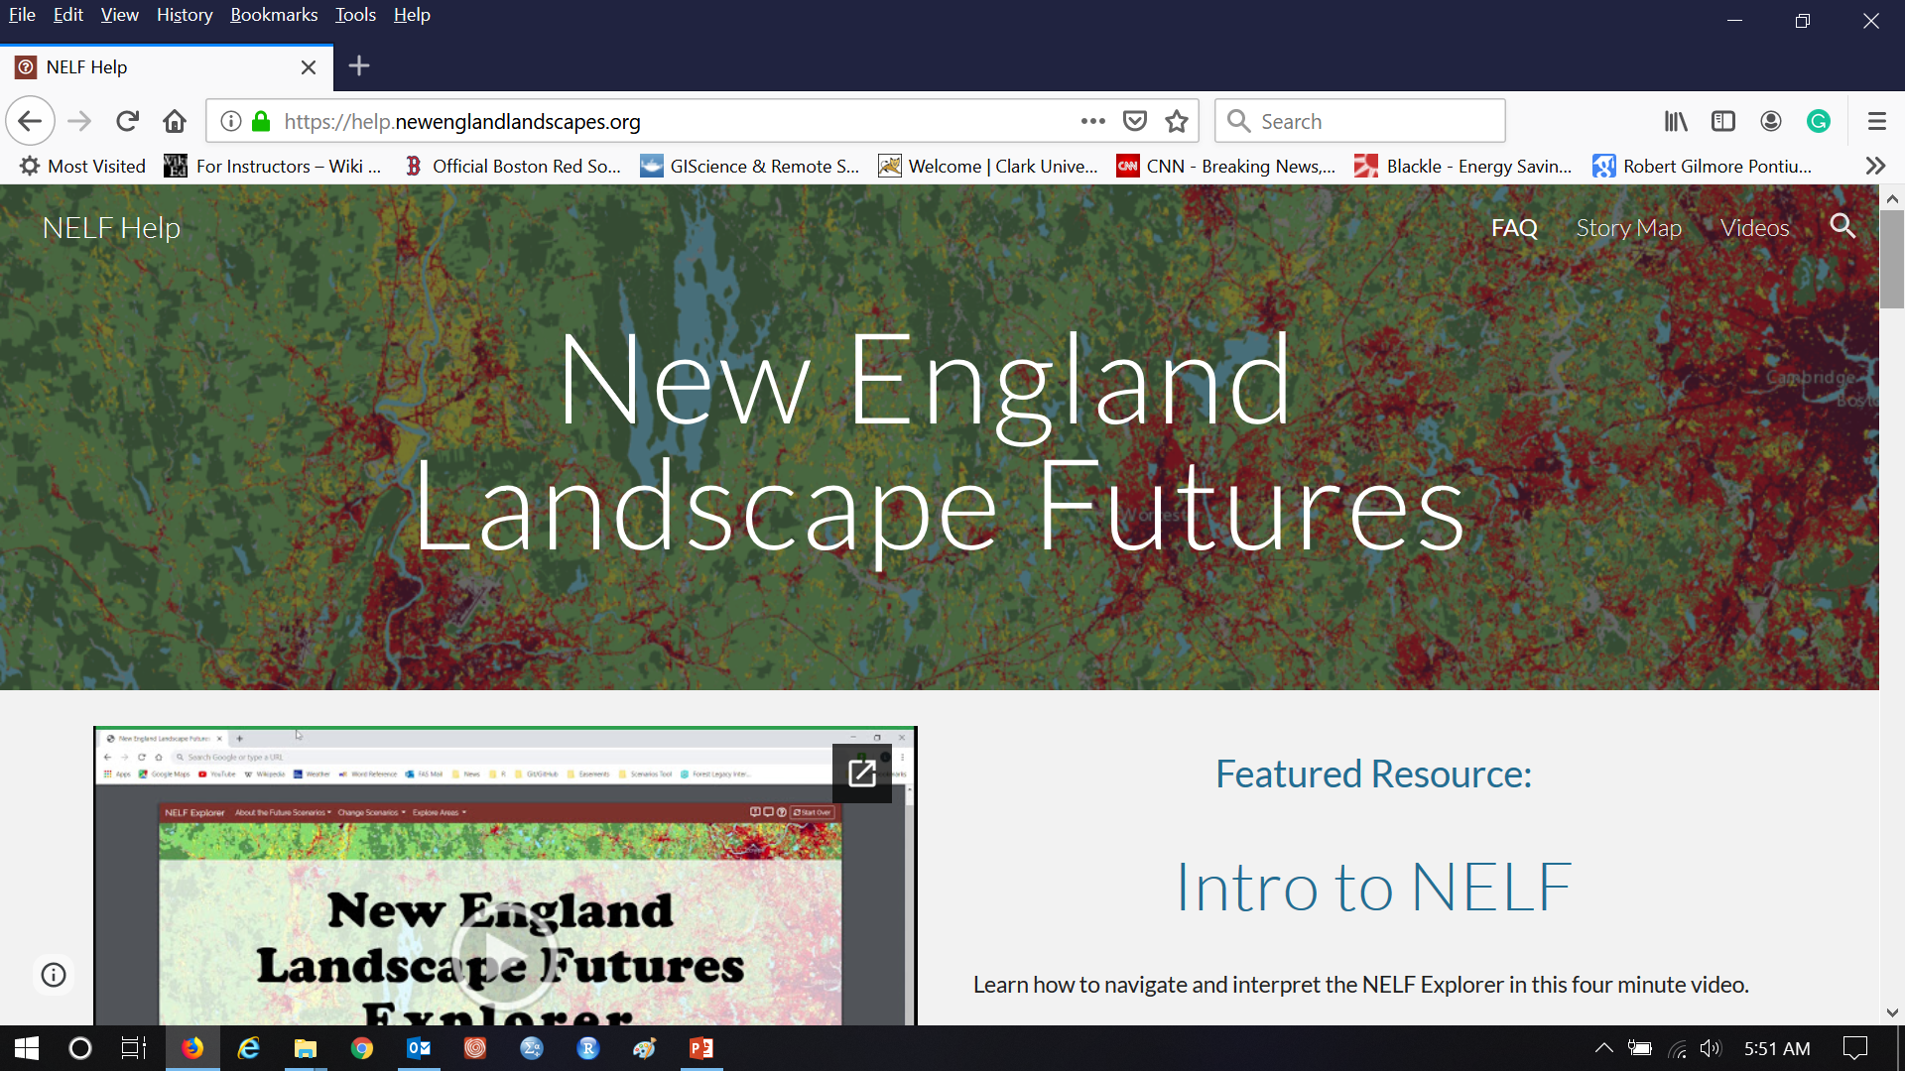
Watch the Introduction video at https://help.newenglandlandscapes.org

Slide 23
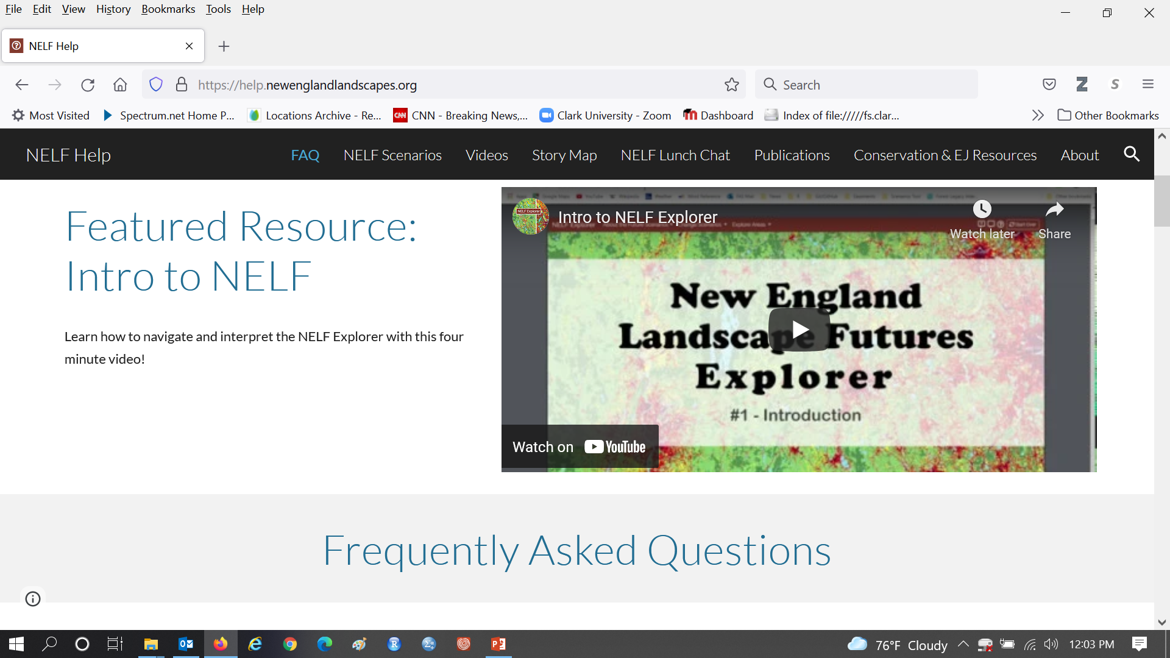
Read Frequently Asked Questions at https://help.newenglandlandscapes.org

Slide 24
Vocabulary
A prediction is the one thing that you think most likely to occur.
A scenario is a story told in words, numbers and maps concerning one possible way the future could be.
A Recent Trends Scenario is a story of extrapolation of recent trends in the patterns of the data.
Is a Recent Trends Scenario a prediction? No
Is it possible to make a Recent Trends Scenario when you lack knowledge of the processes? I think you necessarily need to know the process, all you need if the storylie cos=cerning the disctintive process like what NELF has
NELF has various alternatives to the Recent Trends Scenario. Each Scenario has a storyline concerning distinctive processes. NELF conducted meeting with stakeholders to develop the storylines.

Slide 25
Annual Deforestation Rate in the Brazilian Amazon
Some people use the phrase “Business as Usual Scenario” rather than Recent Trends Scenario.
Is Business a pattern or a process?
Is a Trend a pattern or a process?
Has business be usual in Brazil?
How would you create a recent trends scenario based on these data?
-84%
190%
Fonte: Imazon
Source: PRODES, INPE

